Slide 1
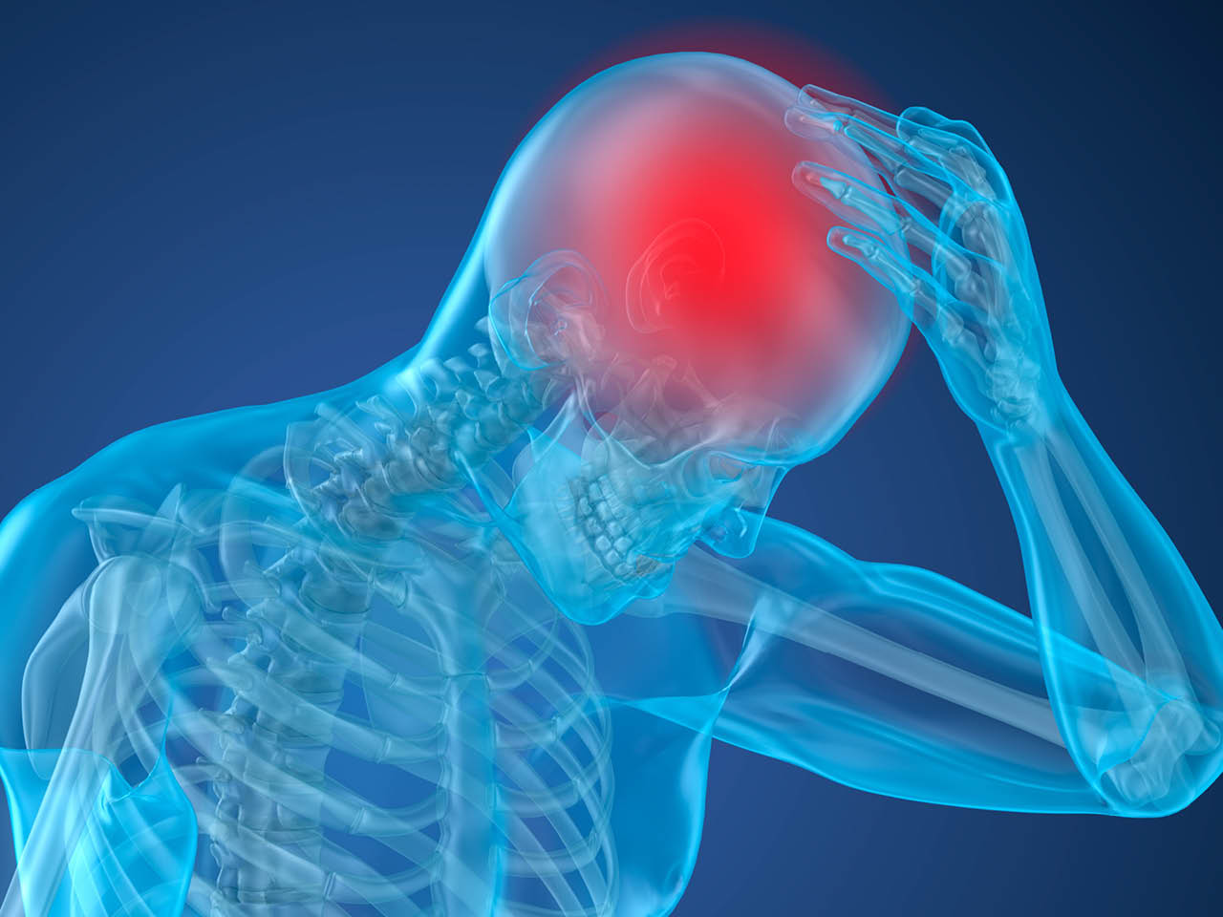
Predicting Strokes
By Mohammed Al-Shalchy

Slide 2

Goal
Is it possible to make predictions on the likelihood of someone having a stroke or not?
What factors could lead to someone suffering a stroke? Is it age? Gender? Weight?

Slide 3
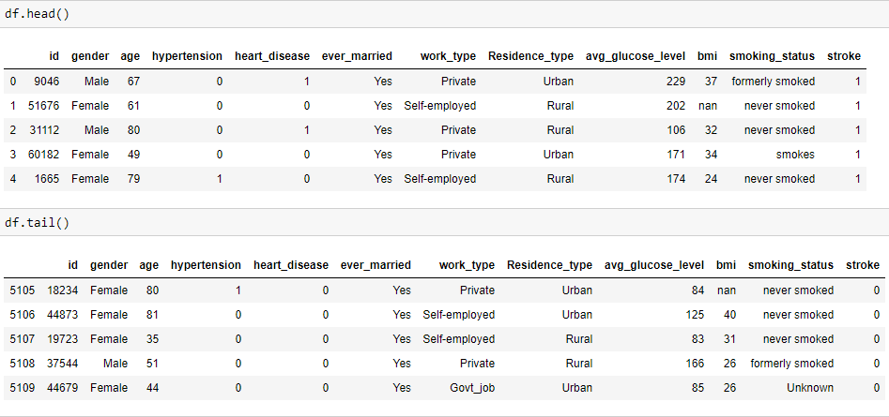
Dataset
Shape: (5110, 12)

Slide 4
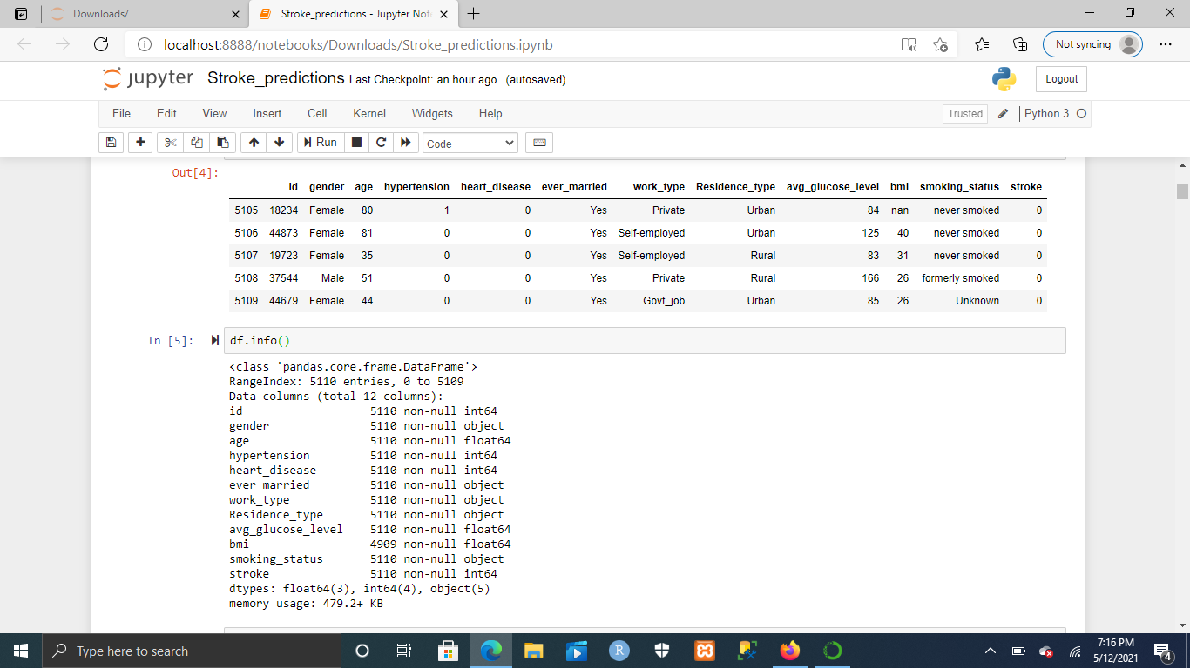
Data Cleaning

Slide 5
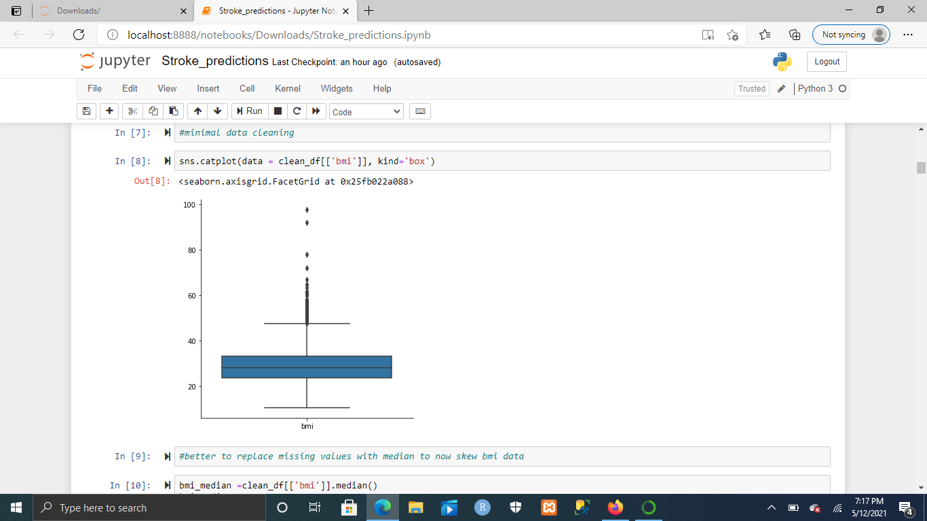
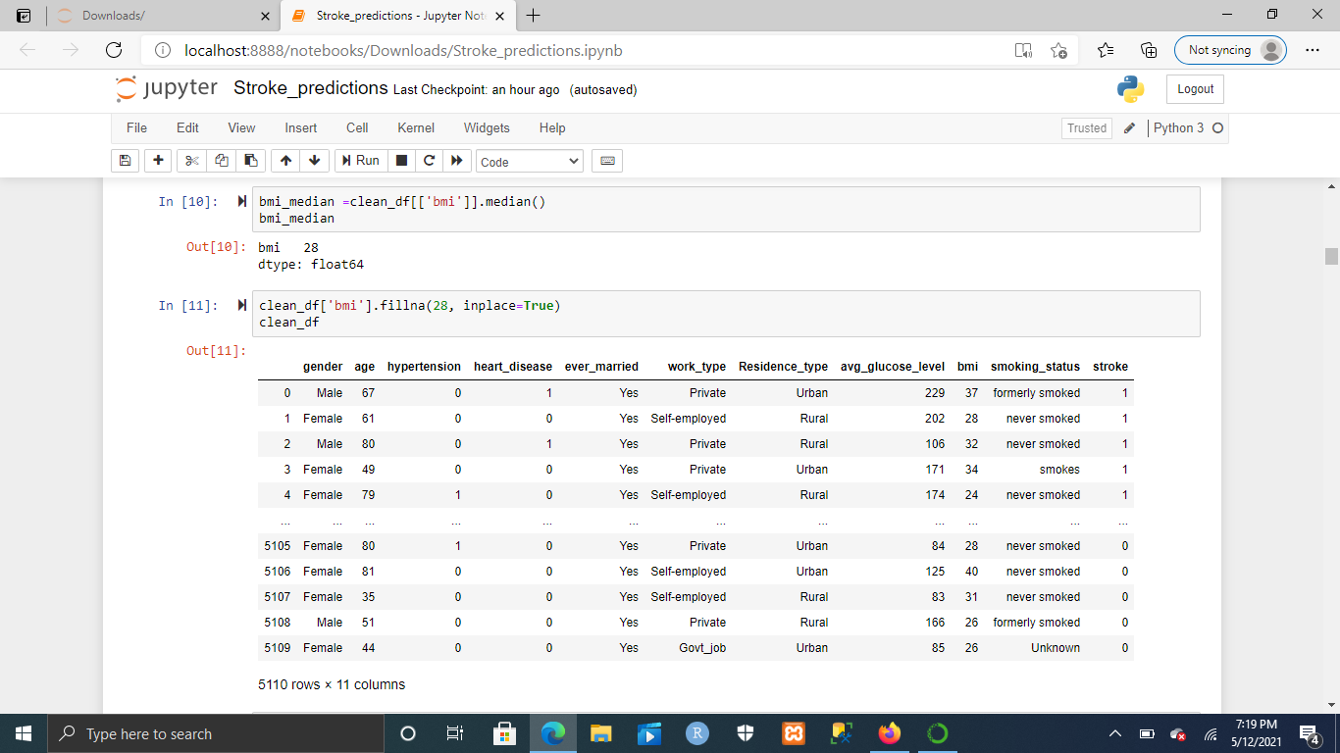
Data Cleaning (2)

Slide 6
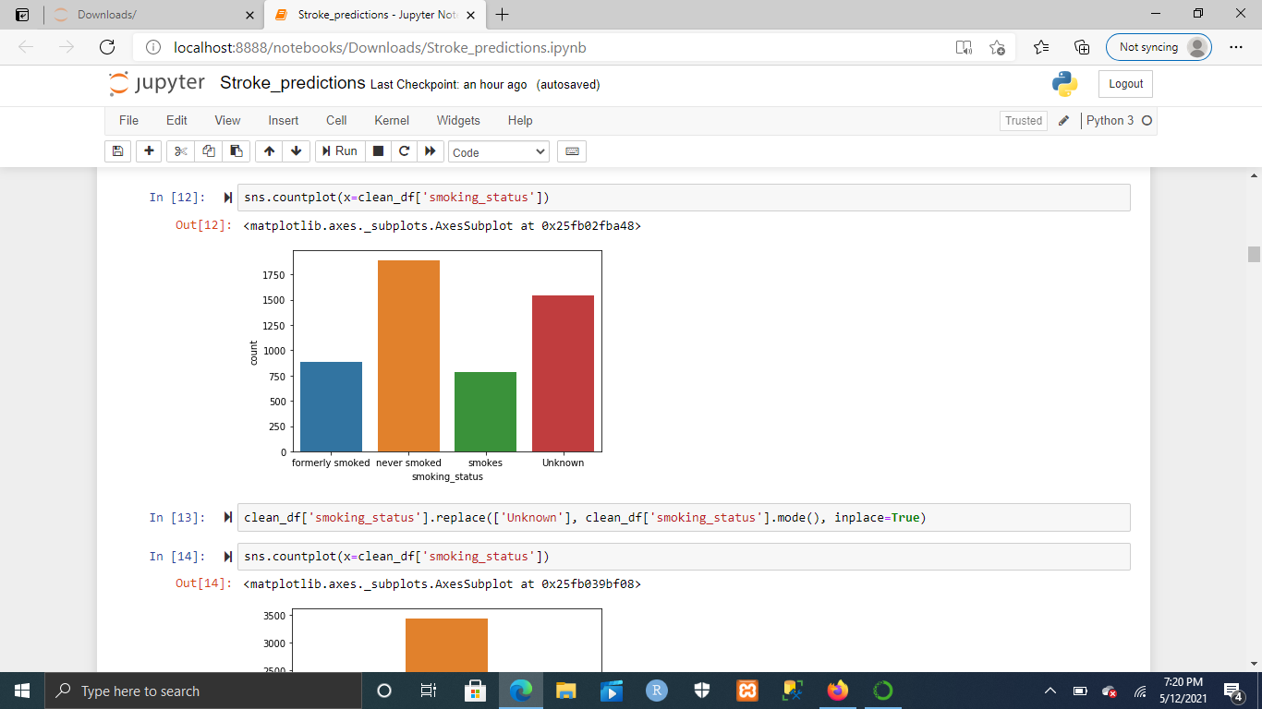
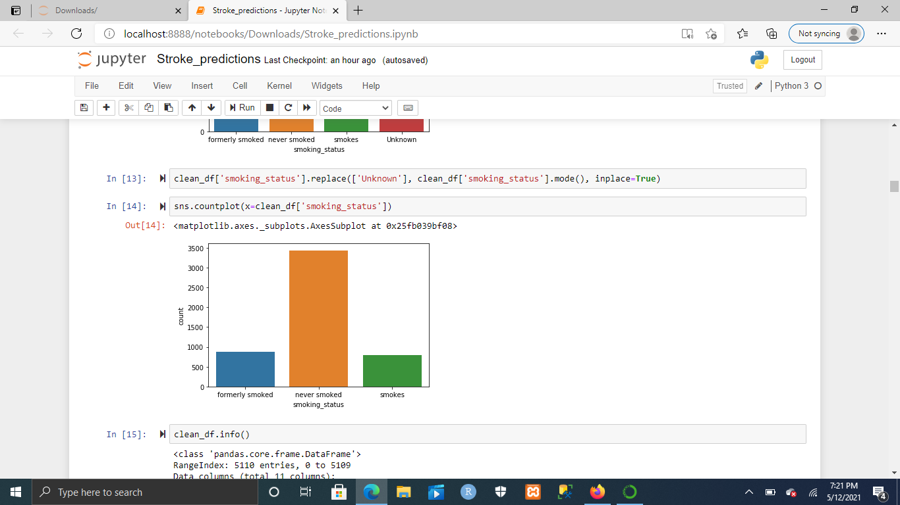
Data Cleaning(3)

Slide 7
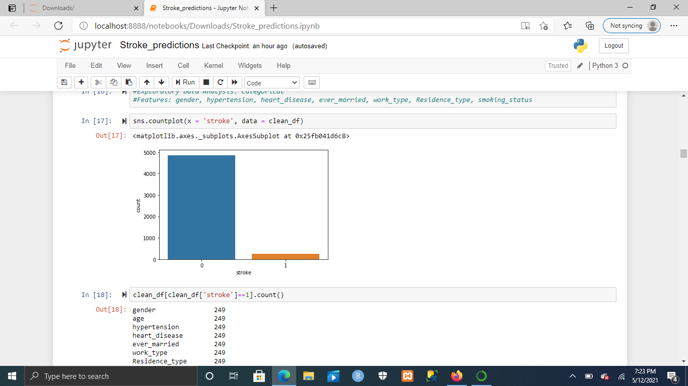
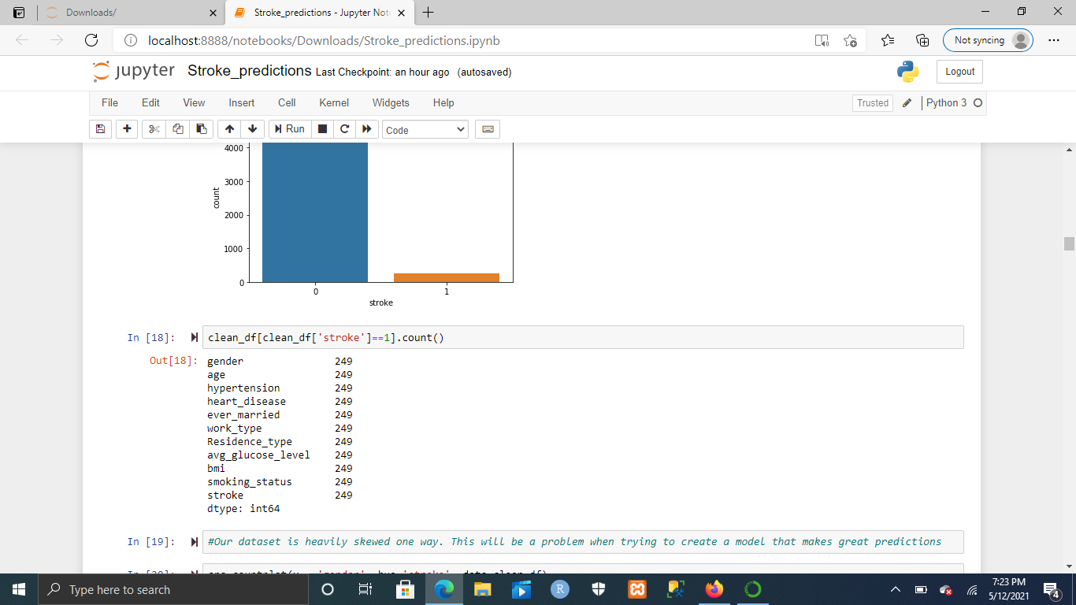
Exploratory Data Analysis: Stroke

Slide 8
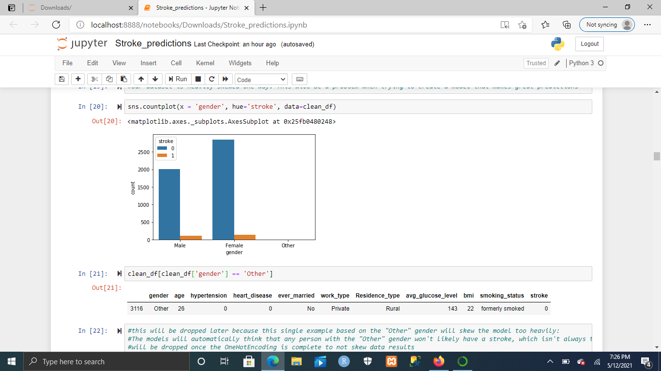
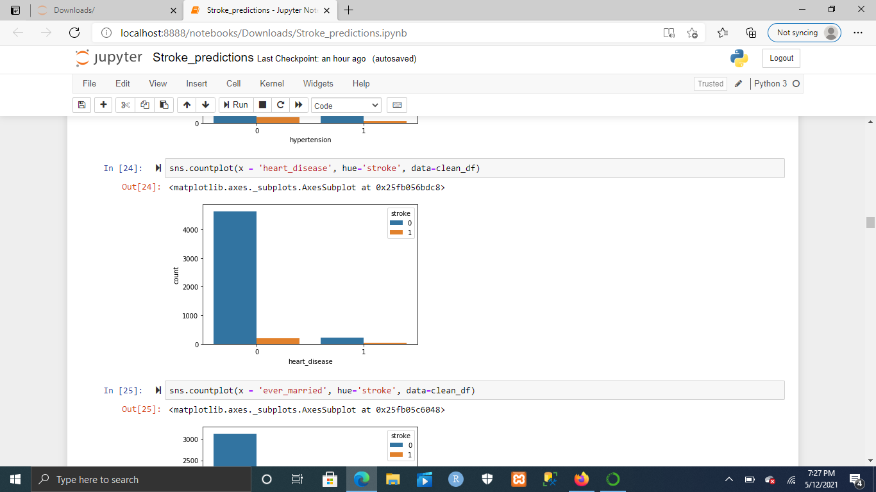
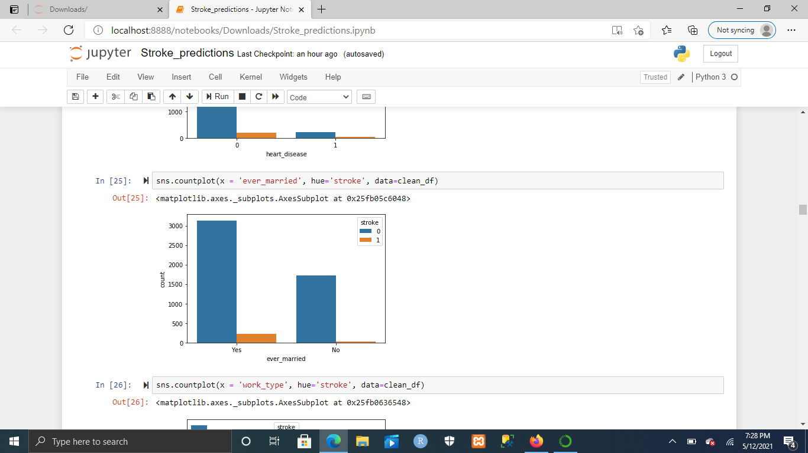
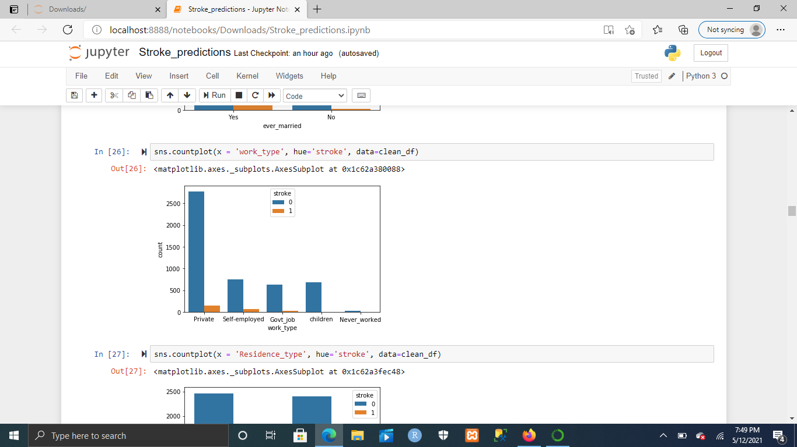
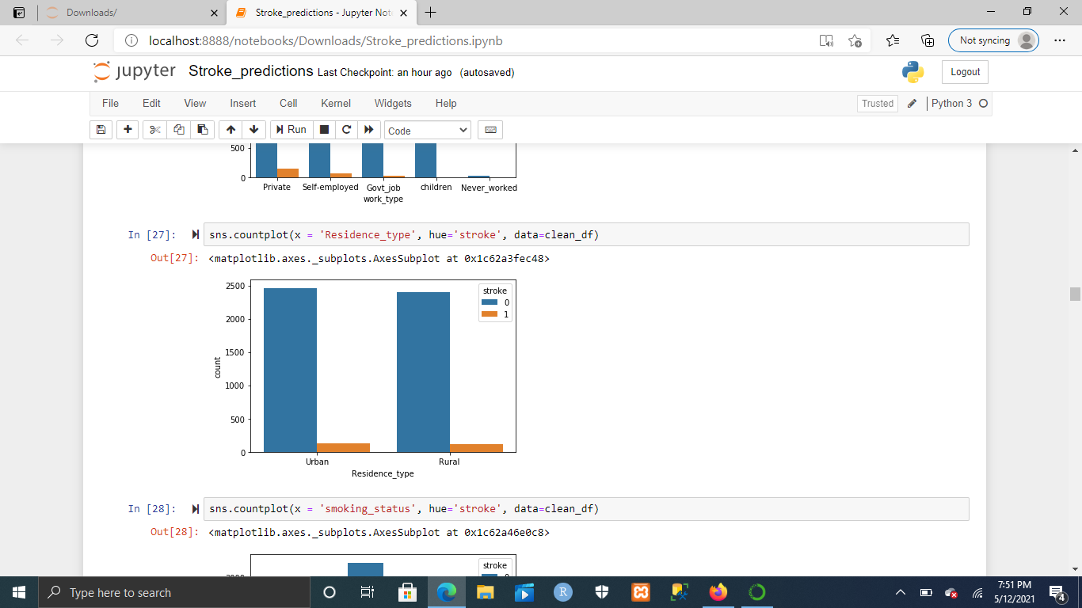
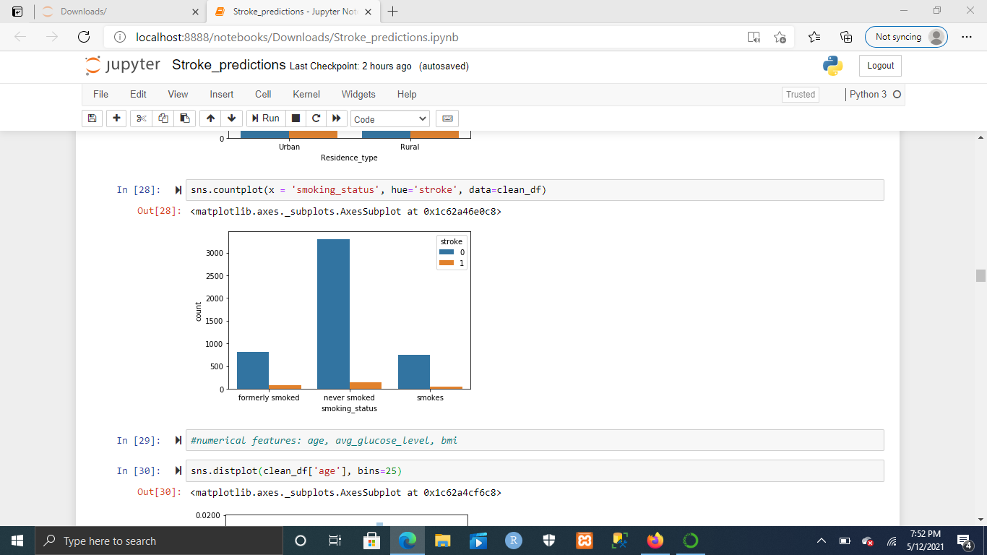
Exploratory Data Analysis: Categorical

Slide 9
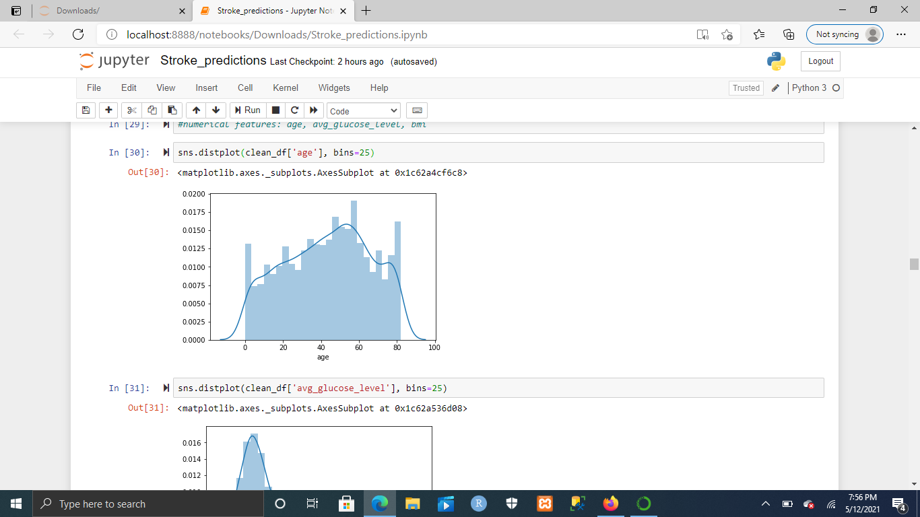
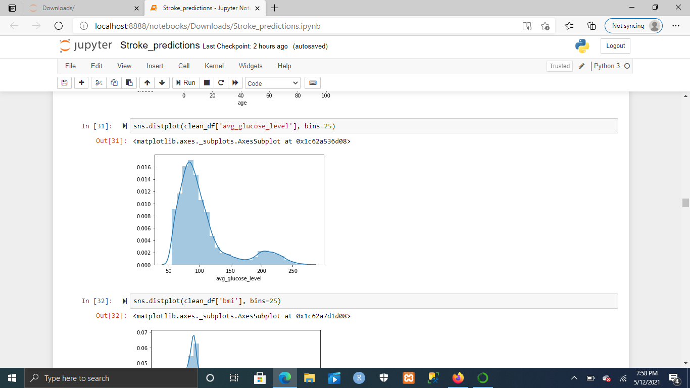
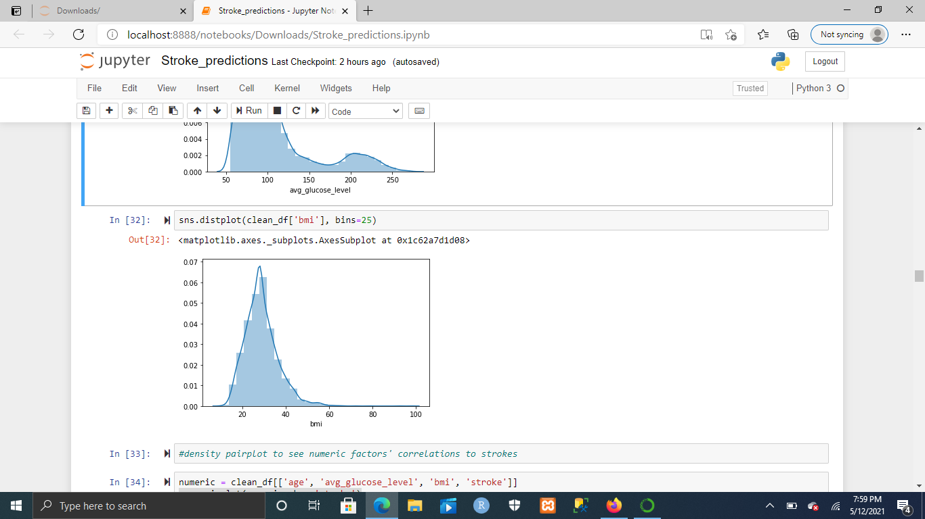
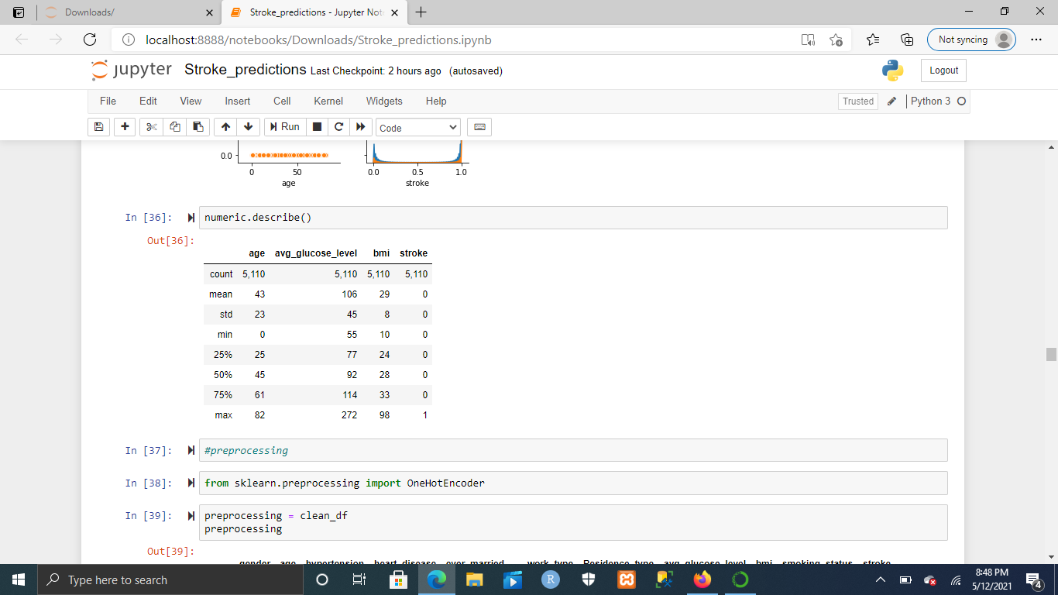
Exploratory Data Analysis: Numerical

Slide 10
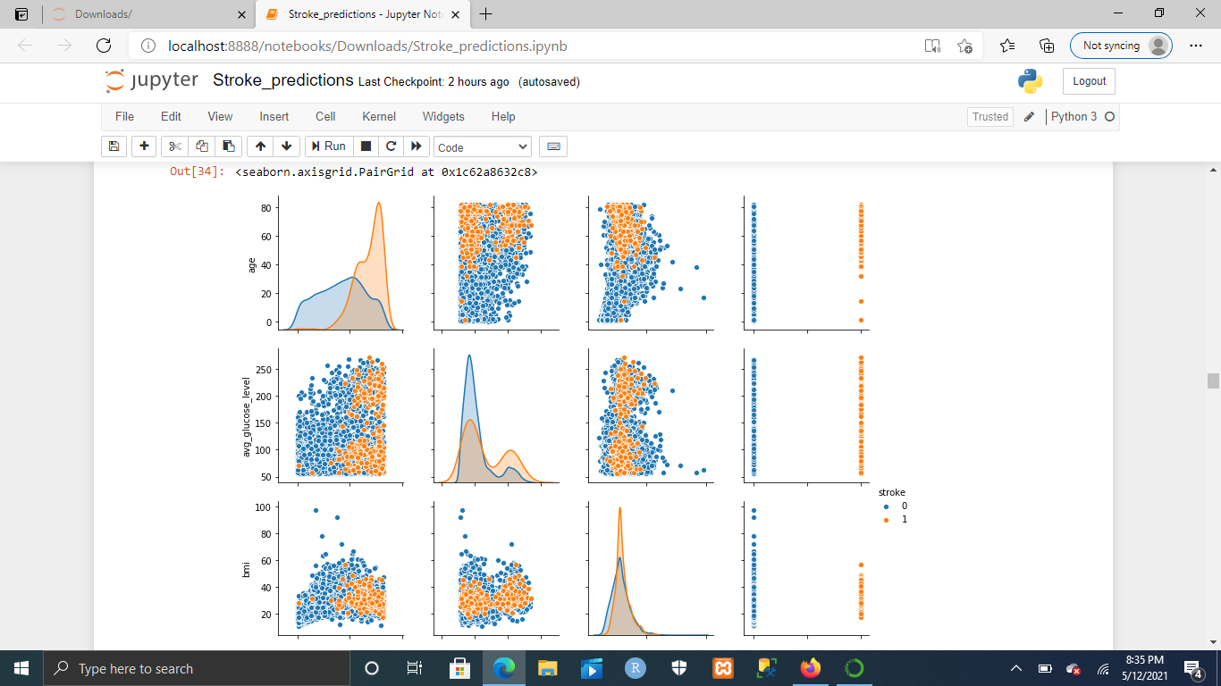
Numerical Correlations

Slide 11
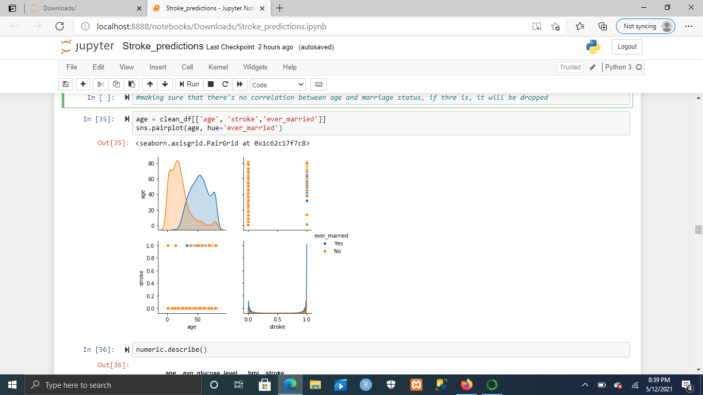
Relationship Check: Age vs Marriage Status
No strong correlation

Slide 12
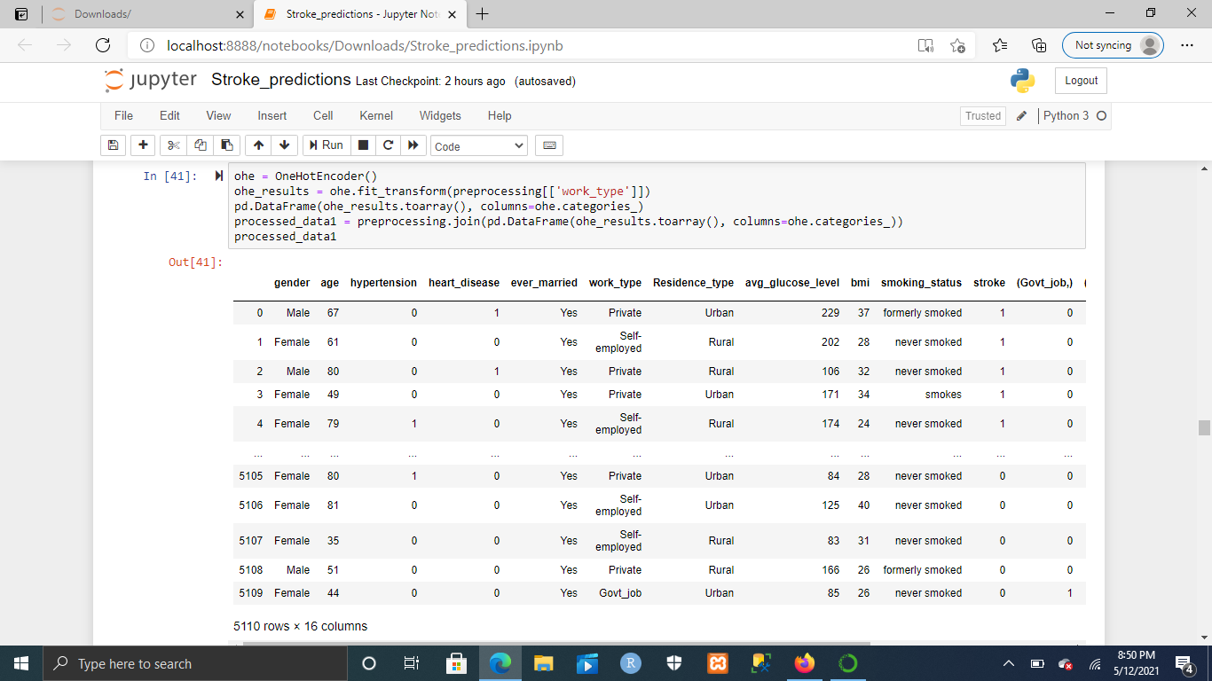
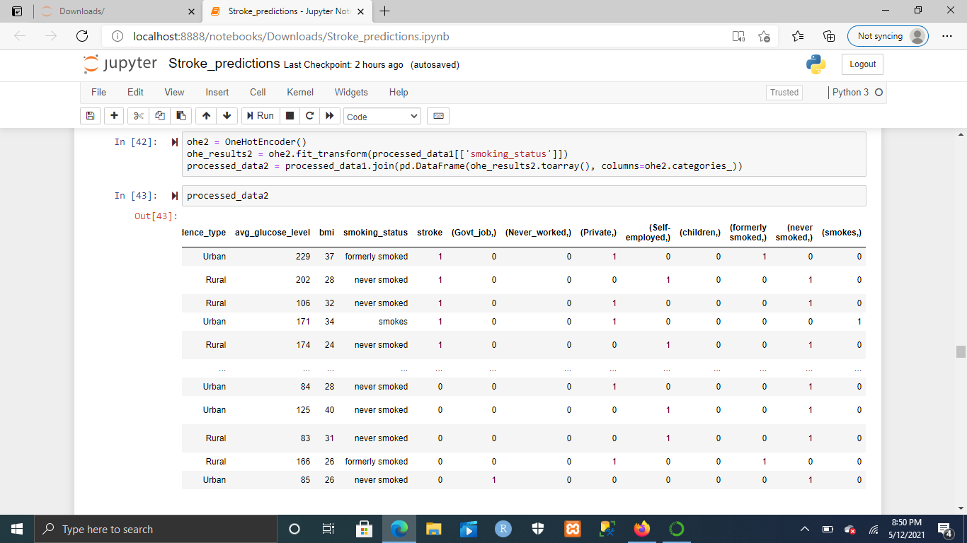
Preprocessing: One Hot Encoding

Slide 13
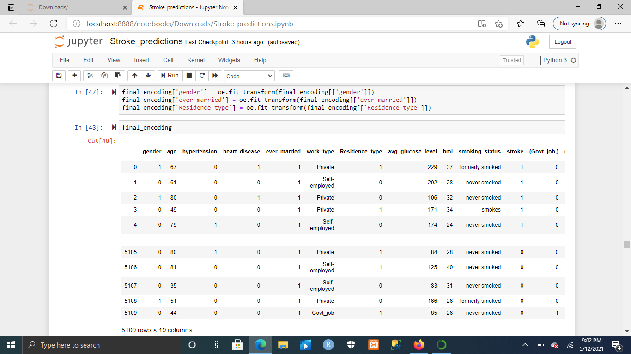
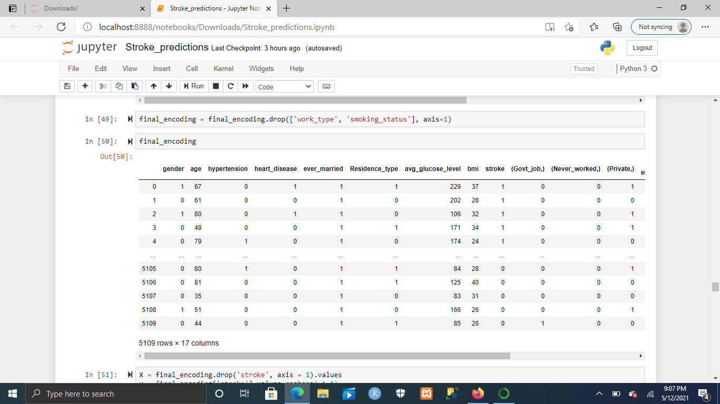
Preprocessing: Ordinal Encoder
oe = OrdinalEncoder()

Slide 14
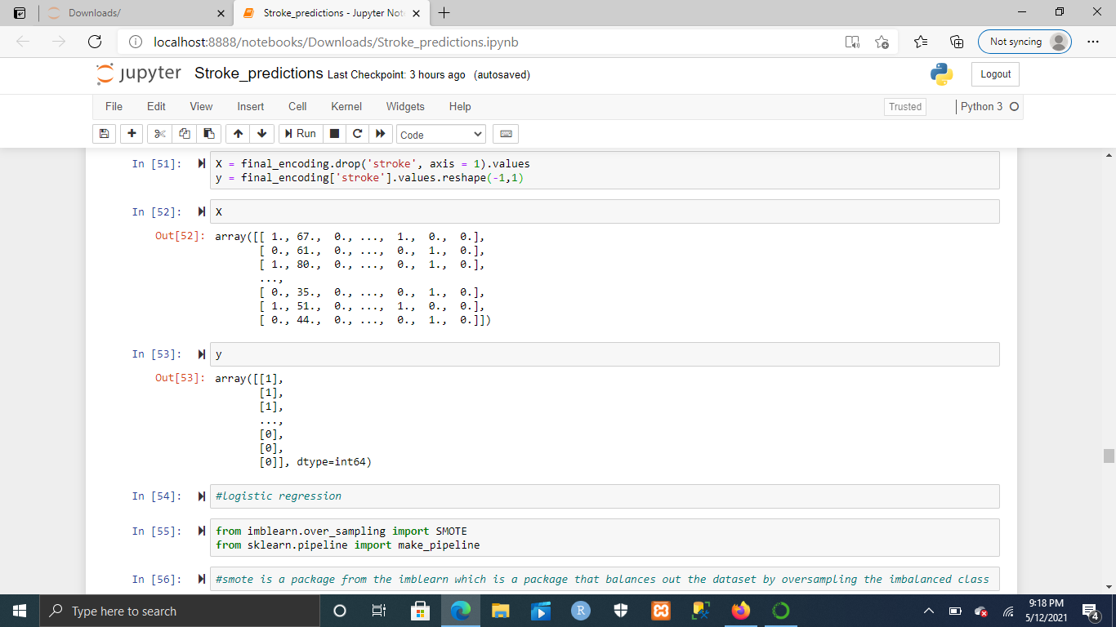
Declaring X and y

Slide 15
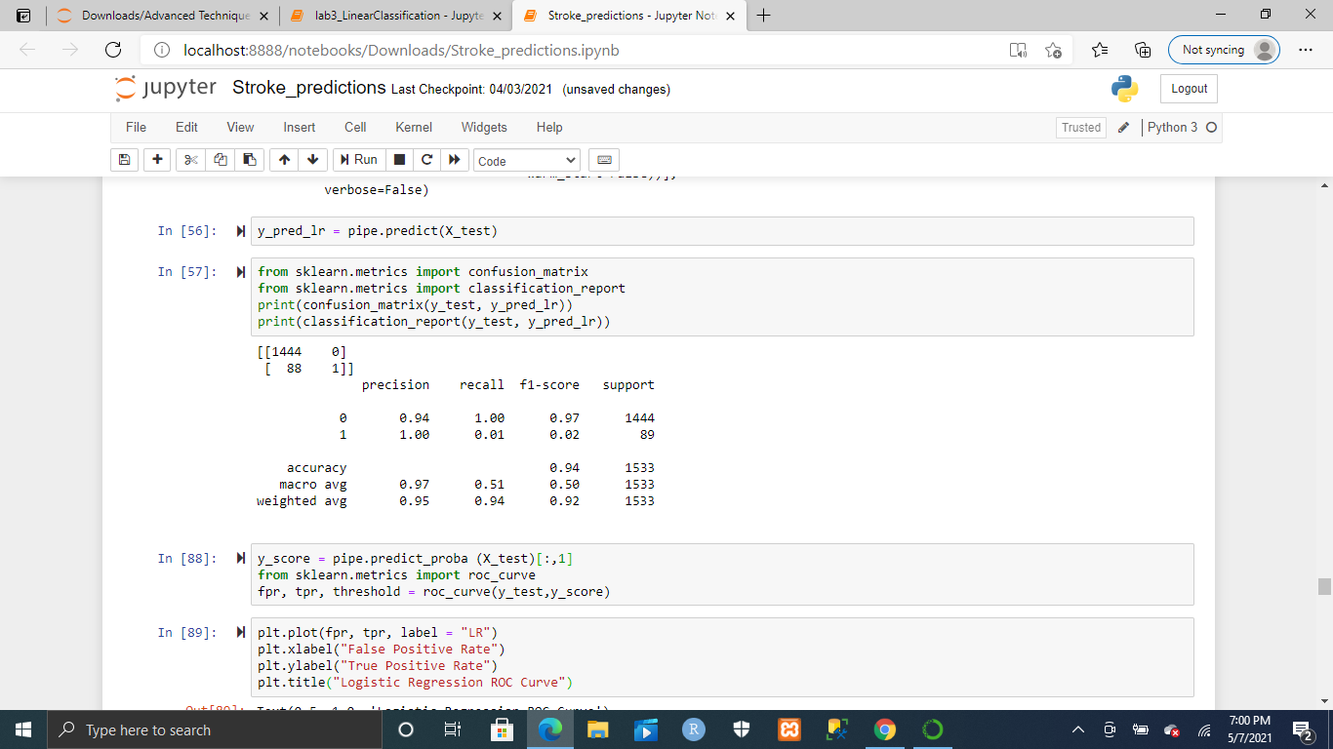
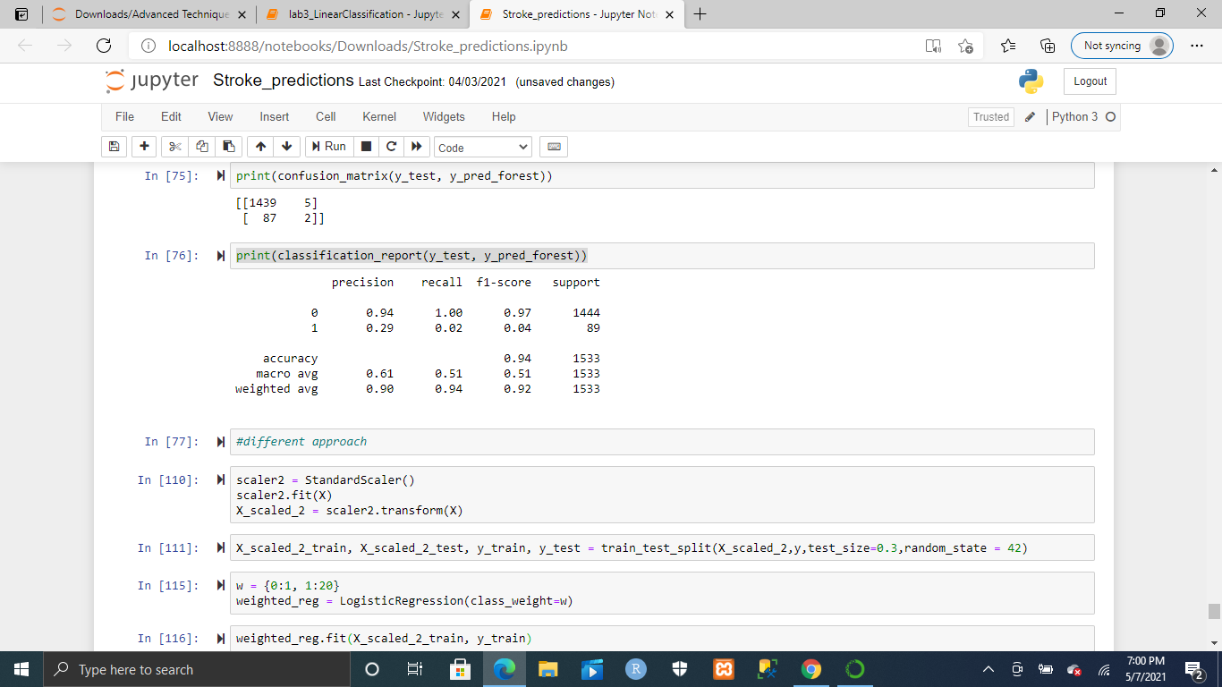
Problem With Imbalanced Datasets

Slide 16
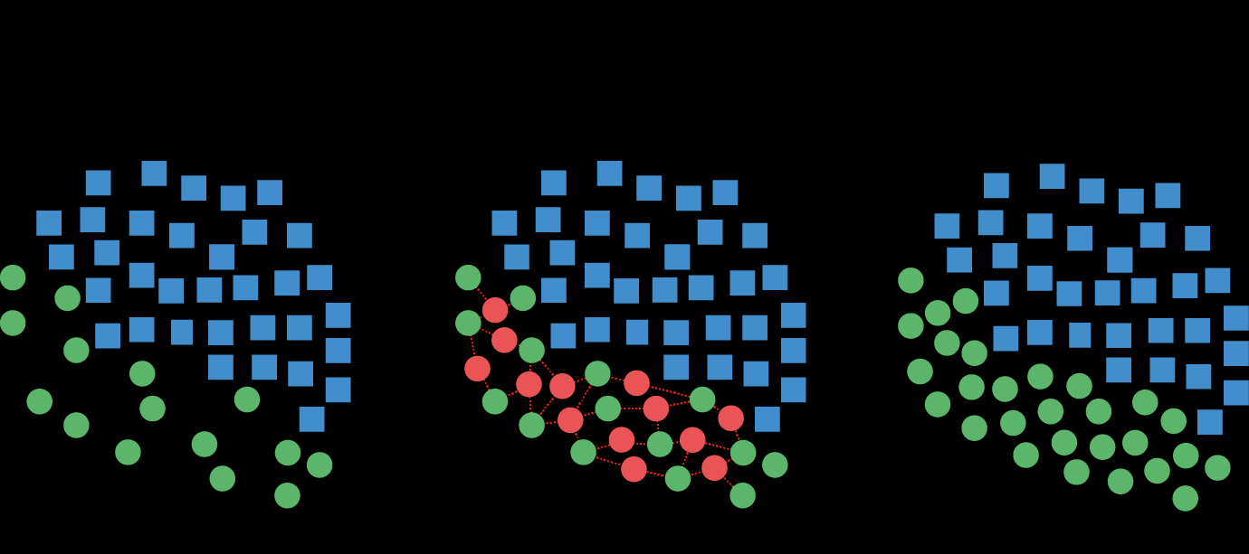
SMOTE
from imblearn.over_sampling import SMOTE

Slide 17
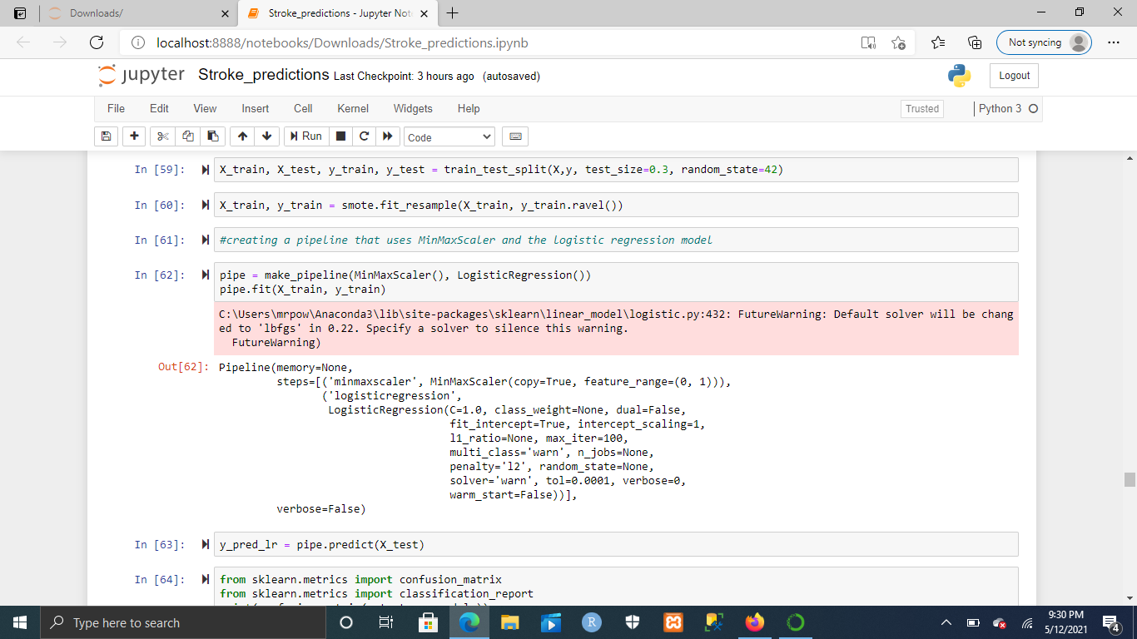
Logistic Regression

Slide 18
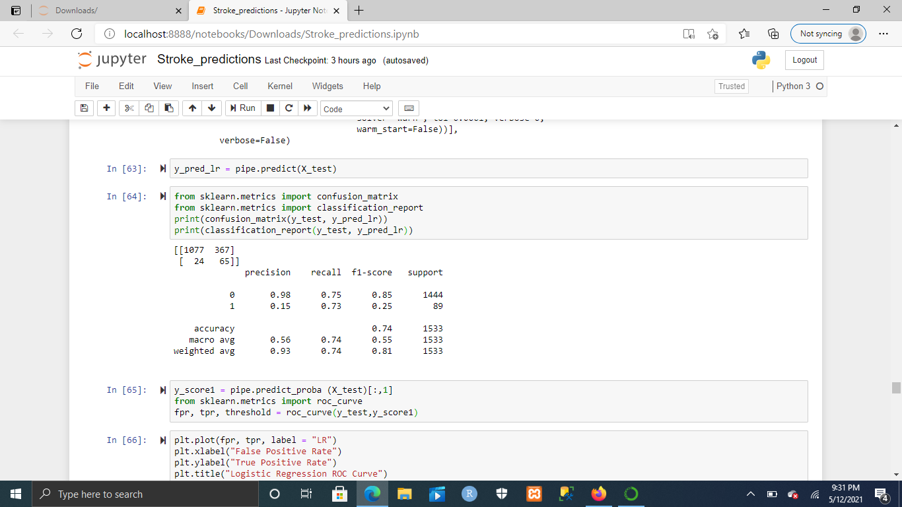
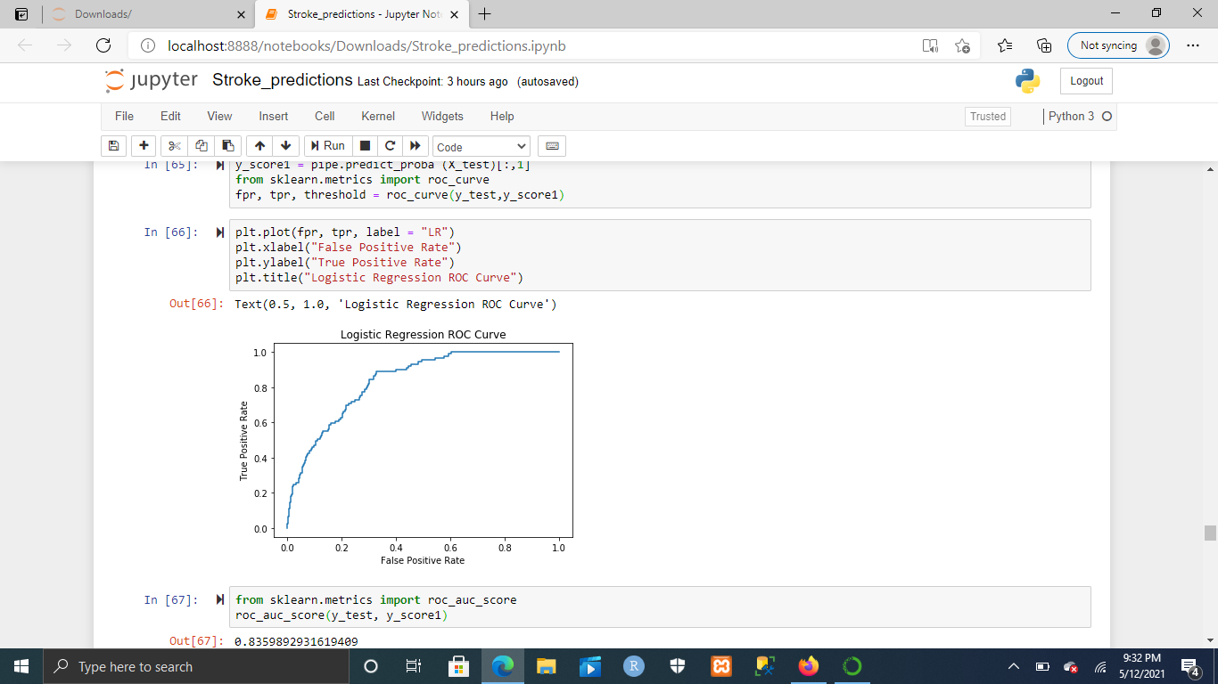
Logistic Regression Results

Slide 19
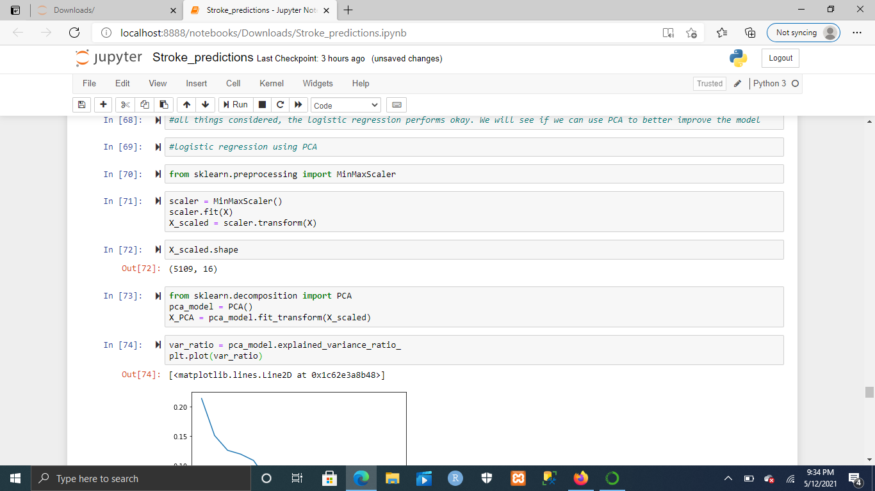
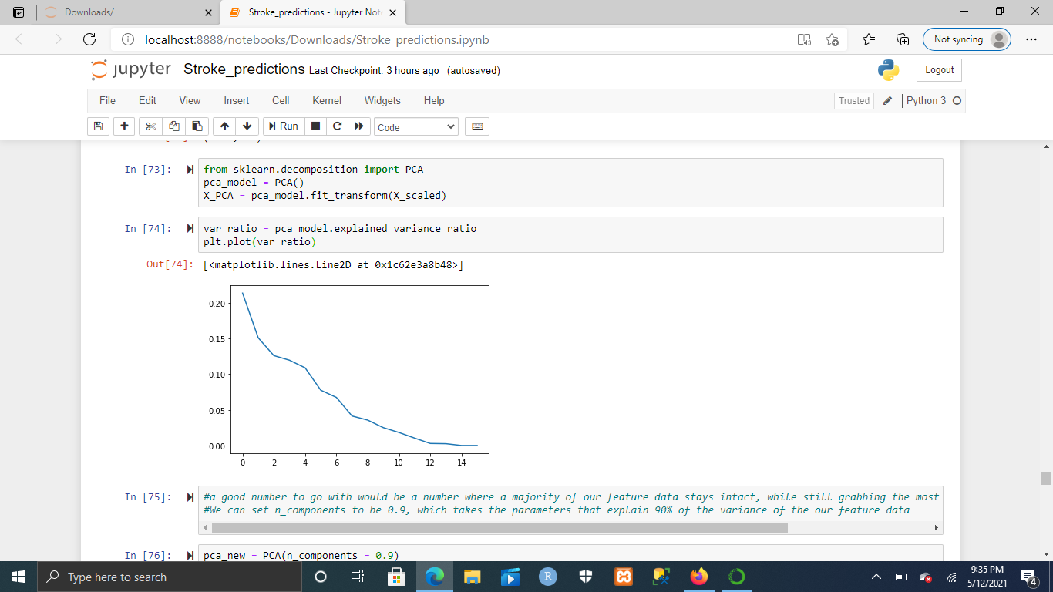
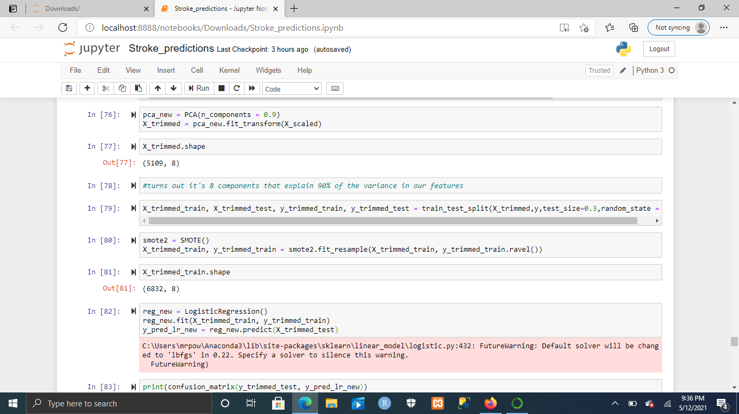
Logistic Regression: PCA

Slide 20
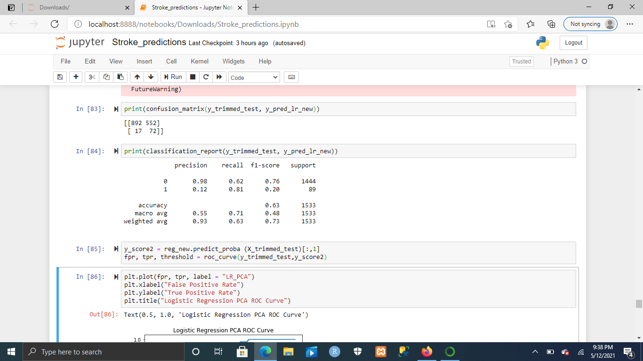
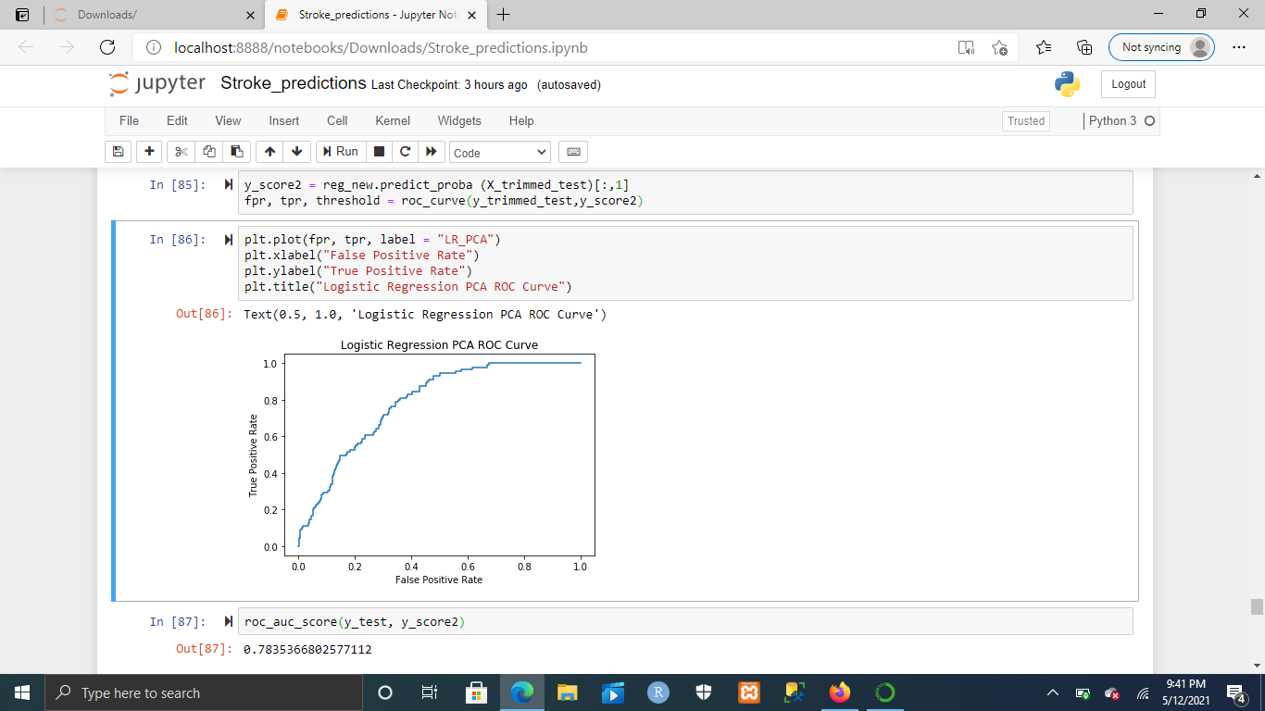
Logistic Regression PCA Results

Slide 21
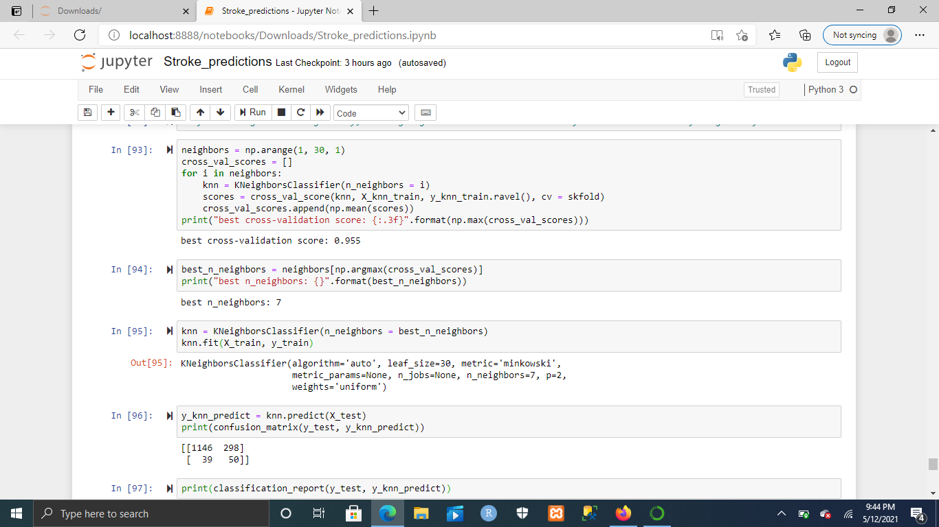
KNN: Grid Search

Slide 22
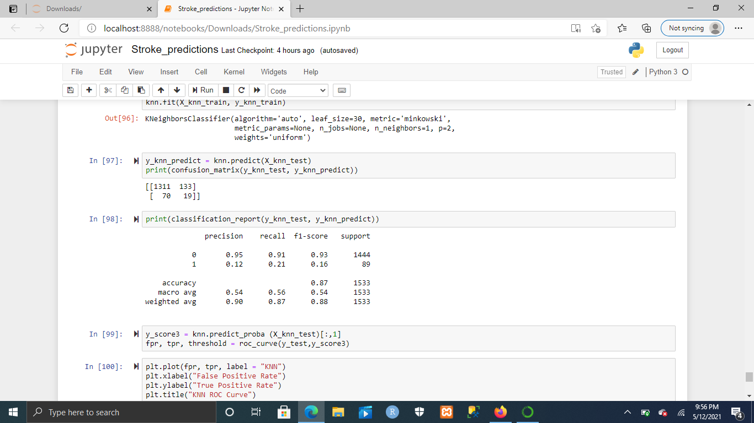
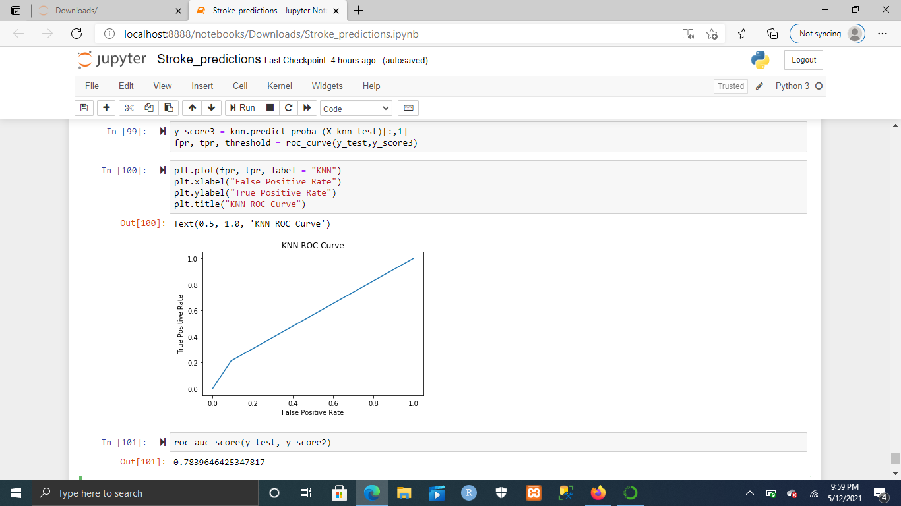
KNN: Results

Slide 23
Conclusion
It’s possible to build a model that would do an okay job at predicting whether someone is likely to have a stroke or not
KNN performed the worst out of all the models
Logistic Regression provided the best overall model for predicting whether someone is likely to have a stroke or not
Logistic Regression with the PCA modification does a better job at finding people who are likely to have a stroke, but has a high false positive rate.

